Slide 1
Beacon Satellite Scintillation Sputnik to Cubesat
Charles Rino
Visiting Scholar, Boston College, Institute for Scientific Research
2013 Beacon Satellite Symposium
8-12 July 2013
Bath, UK

Slide 2
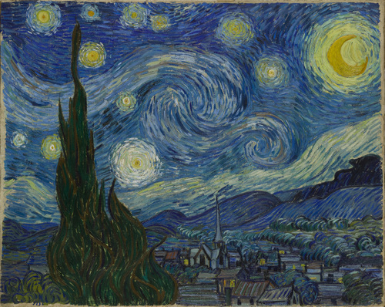
Van Gogh’s Starry Night
from a paper of the same name by M. Colleen Gino
http://www.astrophys-assist.com/educate/starry/starrynight.htm

Slide 3
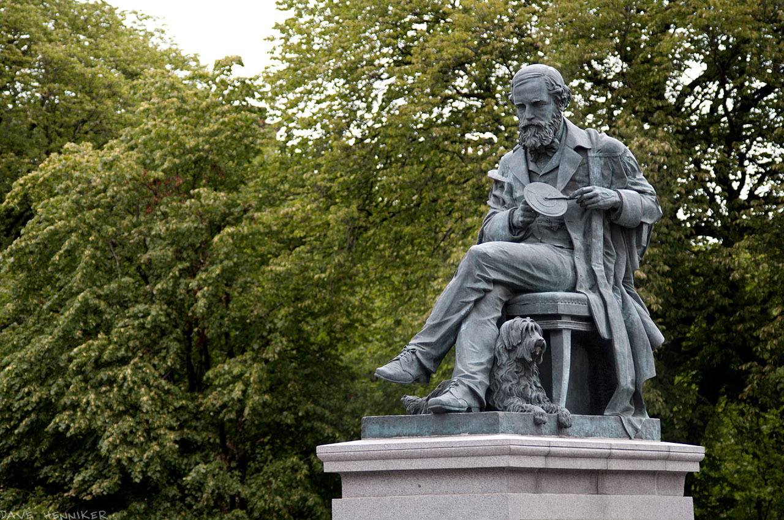
James Clerk Maxwell
Statue commissioned in 2006 to celebrate the 175th anniversary of his birth
Unveiled in 2008

Slide 4
The Technical Legacy of World War II
Radar
Remote sensing, automated fire control, cybernetics
Electronic Intelligence
Electronic computers, information theory, and artificial intelligence
Rocketry
Beacon satellites and space exploration
Nuclear Weapons
Existential threat that profoundly influenced the pace of technology development

Slide 5
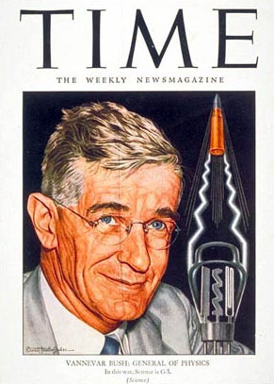
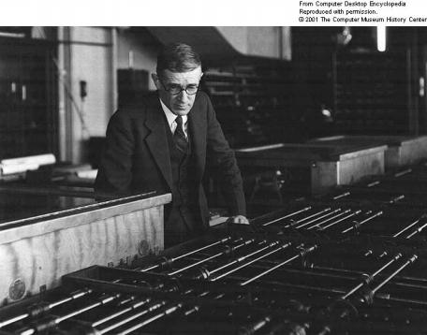
Vannevar Bush
Scientist Visionary 1890-1974
Directed OSRD from 1941 to 1947
Worked for establishment of government agencies to foster the development of WW II technology
Instrumental in establishing the National Science Foundation in 1950
Dwight Eisenhower’s election in 1952 began a period of resistance to big government programs
His differential analyzer used
during WW II to calculate
firing tables for large guns

Slide 6
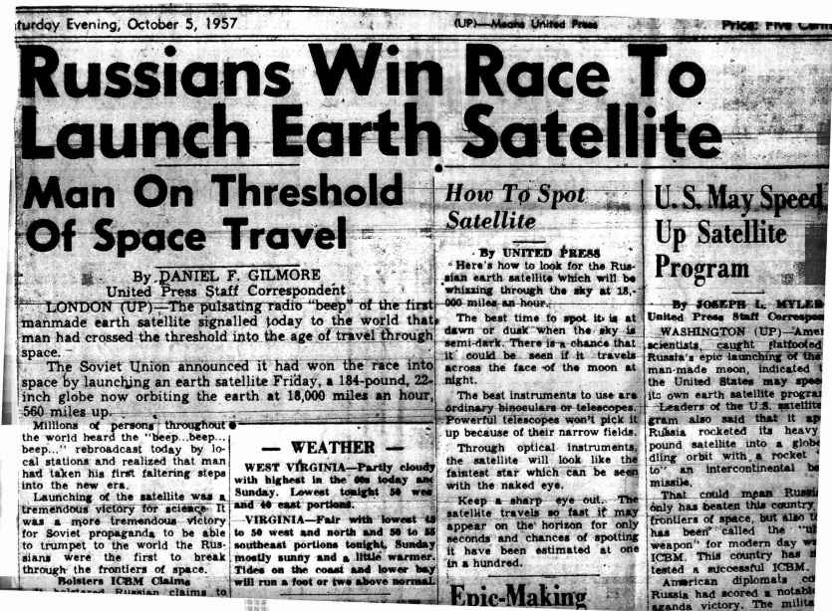
SPUTNIK
4 October 1957

Slide 7
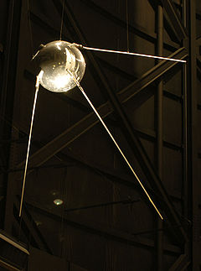
Sputnik
Within a year of the launch of Sputnik I
both the National Space and Aeronautics
Association (NASA) and the Advanced Research
Projects Agency (ARPA) were established
Radio amateurs around the world detected
Sputnik’s 20 and 40 MHz Beacon signals
Scientists at the Johns Hopkins Applied
Physics Laboratory (APL) were tasked with
determining Sputnik’s orbit
Phase Screen
By observing Sputnik’s Doppler shift from a know location the orbit could be
precisely determined. APL scientists realized that if the satellite could broadcast its position to an observer, the process could be reversed to determine the observer’s location.

Slide 8
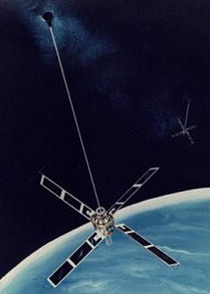
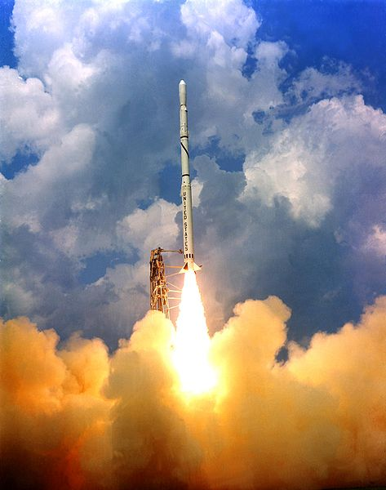
Navy Navigation Satellite System
TRANSIT
SCOUT-D
Within a decade of
Sputnik I satellite
navigation using
VHF-UHF beacons
was realized (1964)
Rapid development was stimulated by Polaris submarine positioning requirements for launching nuclear missiles
Phase Screen
The robust solar-powered transit satellites and the Scout-D launch vehicles
were so reliable that an large excess inventory developed

Slide 9
Wideband
In the late 1960s Stanford Research Institute (now SRI International) developed a multi-frequency satellite beacon and receiver system for the Defense Nuclear Agency (DNA)
The objective was to measure UHF frequency coherence under highly disturbed conditions
In 1975 an attempted Wideband launch as a secondary Air-Force satellite payload failed
A year later a TRANSIT spare carried the DNA Wideband satellite into a sun-synchronous polar orbit
Wideband operated for nearly 5 years before the data collection sites were shut down. The beacon functioned for at least a decade
Phase Screen

Slide 10
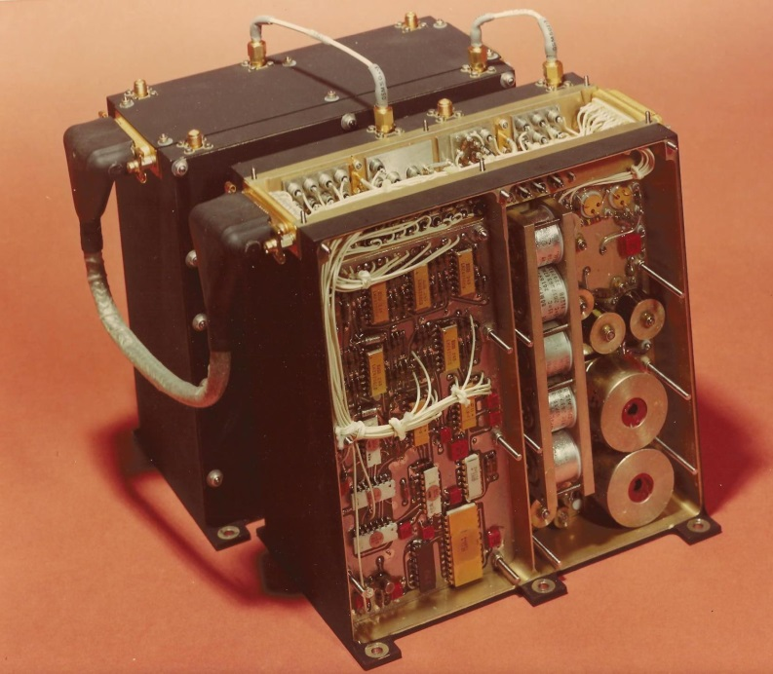
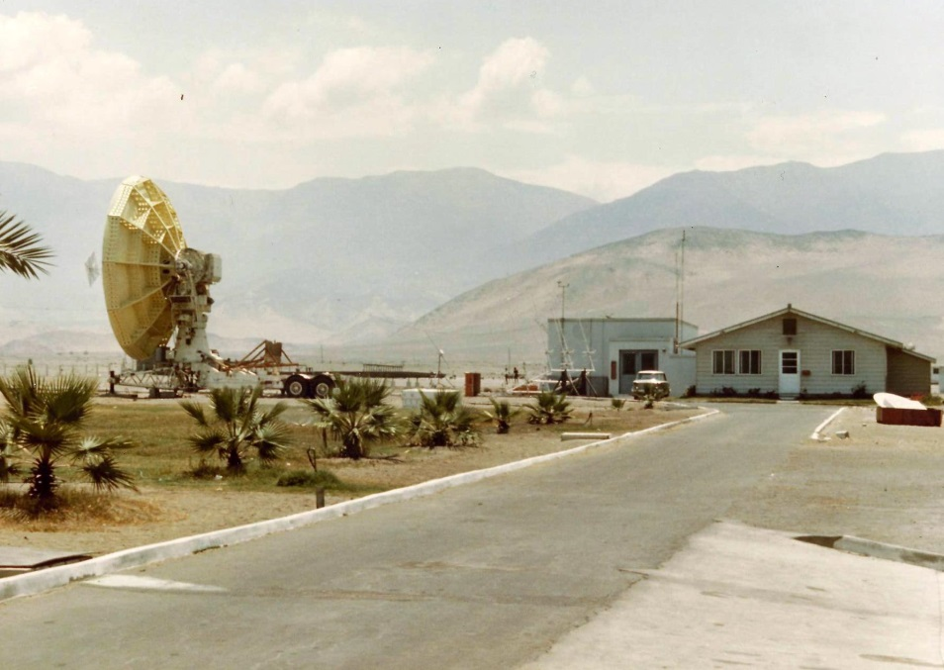
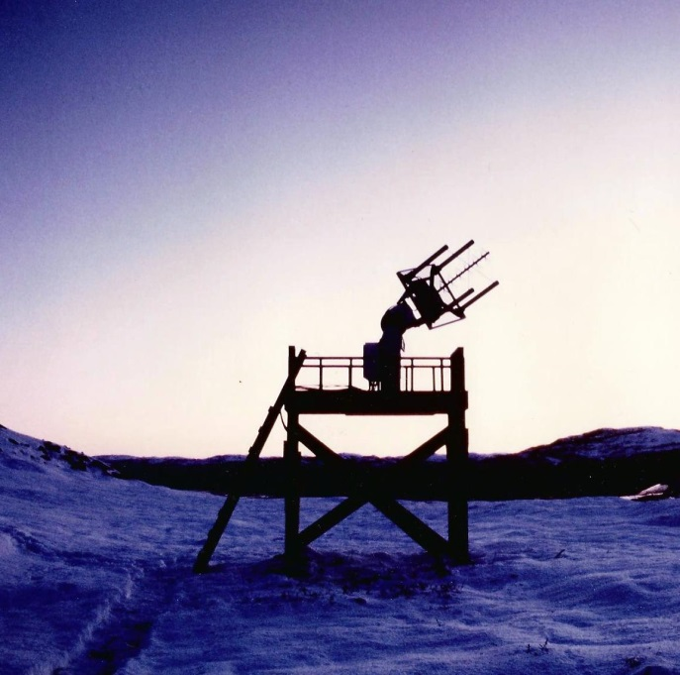
Wideband
(concluded)
Wideband Beacon Payload
S-Band, L-Band, VHF,
UHF (5 frequencies ~11 MHz apart)
Phase Screen
Receiving stations operated
at Ancon, Peru near the
Jicamarca, Radar and at
Poker Flat, Alaska near the
Chatanika Radar
Ancon
Poker Flat

Slide 11
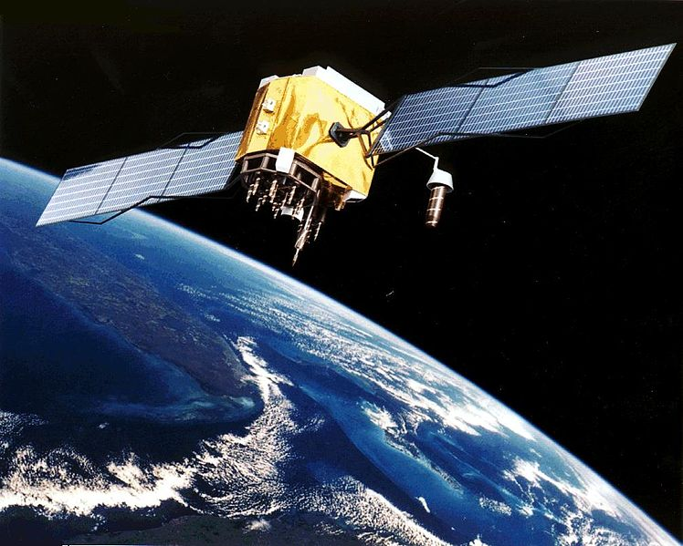
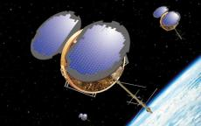
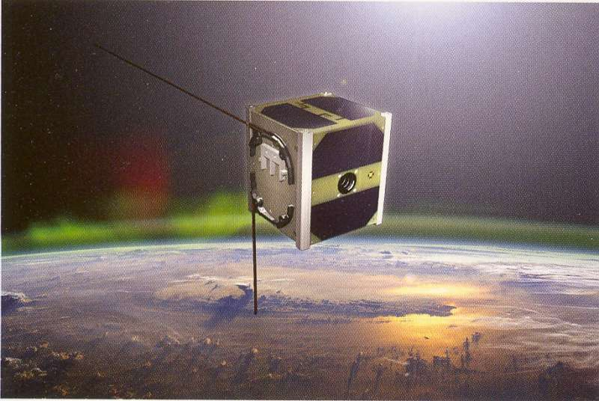
Modern Beacon Satellites
GPS
Operational
1994
Phase Screen
COSMIC
Operational 2006
CUBESAT
First launched 2003

Slide 12
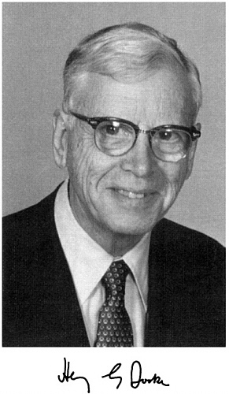
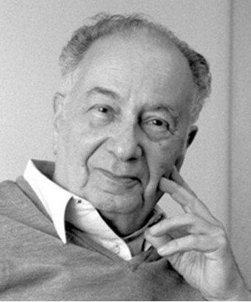
Two Scintillation Pioneers
Jules Aarons
Graduated from City College of NY in 1942 Fulbright Scholar Ph. D University of Paris 1954
1943 -1945 Army Air Force Radio and Radar Officer
1946-1981 AFGL
1981-2005 Professor of Astronomy and Space Physics Boston University
Stimulated DOD scintillation research using radio astronomy well before Sputnik
Stimulated international cooperative scintillation research leading to the morphology of scintillation and its relation to global ionospheric dynamics
The Beacon Satellite Symposia can be thought of as one of his legacies
Henry Booker
Cambridge University degrees in pure and applied mathematics and ionospheric physics
Lecturer at Cambridge working under J. A. Radcliffe 1933 to 1948
Cornell University from 1948 to 1965
Students: Ken Bowles, Don Farley, and William Gordon
Founded the U.C.S.D Department of Applied Electrophysics in 1965, now the Jacobs School of Engineering
Faculty: Jules Fejer, Peter Banks, Irwin Jacobs, Marshall Cohen, Victor Rumsey, and Ian Axford, and Hanes Alfvein (Visiting)
Henry Booker
1910-1988
Jules Aarons
1921-2008

Slide 13
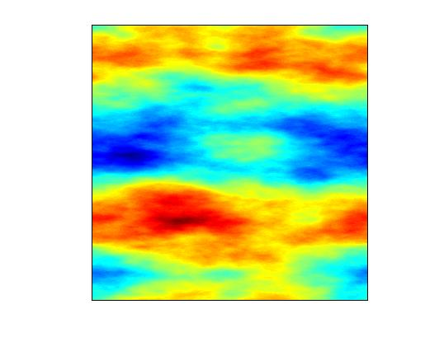
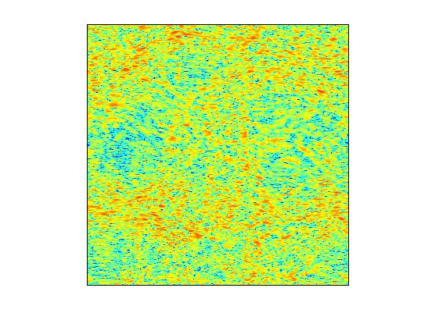
Abstracting The Problem
SOURCE
STRUCTURED
MEDIUM
3D
Phase Screen
OBSERVATION
PLANE
1D Scan
2D

Slide 14
Why So Difficult?
According to Maxwell
Born Approximation
Phase Screen
1
2

Slide 15
The Heyday of Scintillation
1970-2000
URSI USSR meeting held at Yakov Alpert’s IZMIRAN laboratory November 1974
Early results from ATS 6 were reported
September 1988 workshop Tallin, Estonia organized by Professors Tatarski and Ishimaru
Initiated collaborations and friendships that have persisted to this day
An outgrowth was a week-long meeting held at the University of Washington in 1992. The published collection of invited papers edited by Tatarski, Ishimaru, and Zavronity is the finest compendium of propagation in random media available
1982 review papers by Yeh & Liu and Aarons, Special issues of Radio Science (Jan., 1975), JOSA (Dec.,1985), and a new journal, Waves in Random Media (1991) were dedicated to the subject
Calculation of field moments involves the expectation of products of fields and the refractive index variation
Well before Sputnik it was known that Russian researchers had mastered this computation
Translations of Tatarski’s seminal book and numerous papers by Russian scientists were widely circulated in the 1960s. The 1971 review paper by Barabanenkov summarized this work
A key result was a hierarchy of first-order differential equations of increasing complexity that characterize the complex field moments
In spite of the cold war, an active period of U.S.S.R - U.S. exchange and collaboration followed
Phase Screen
Archived material kindly recovered by Valery Zavrotny and Akira Ishimaru

Slide 16
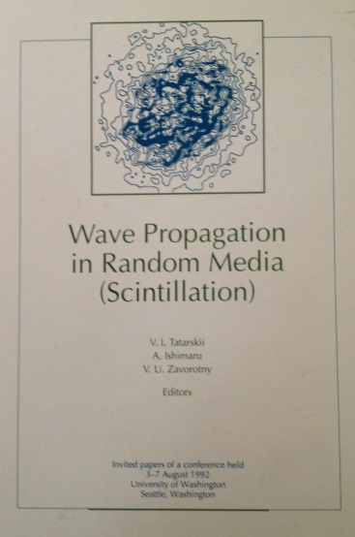
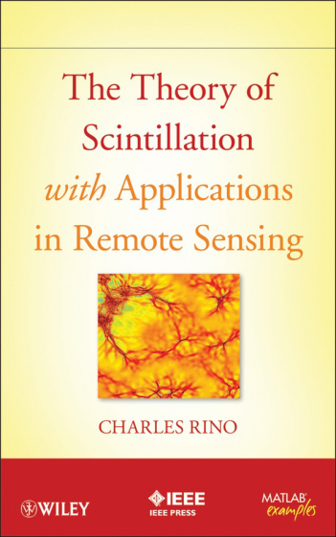
Scintillation Road Map
3D
PROBABILISTIC
MODELS
2D
DIRECT
INTEGRATION
FIELD
REALIZATIONS
PDFS
PARABOLIC
APPROXIMATION
MOMENT
EQUATIONS
&
PATH
INTEGRALS
COHERENCE
MEASURES
EQUIVALET
PHASE SCREEN

Slide 17
Missing Colleagues
Kung Chie Yeh (1992)
1982 Review Paper with Chao Han Liu
Roger Dashen (1995) & Stanley Flatte (2007)
Ocean Acoustics
Santimay Basu (2013)
AE-E and Original work with Emanuel Costa
Phase Screen

Slide 18
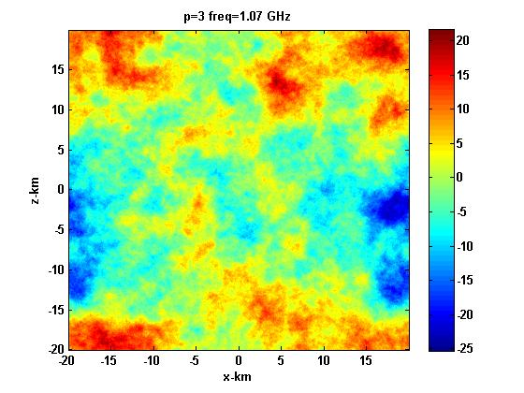
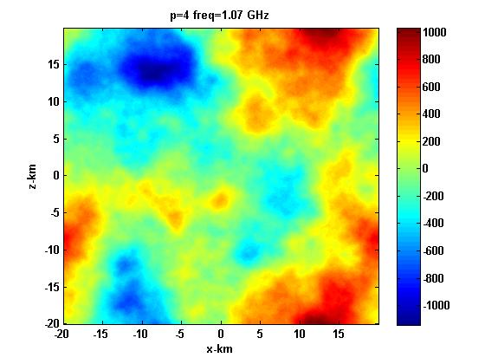
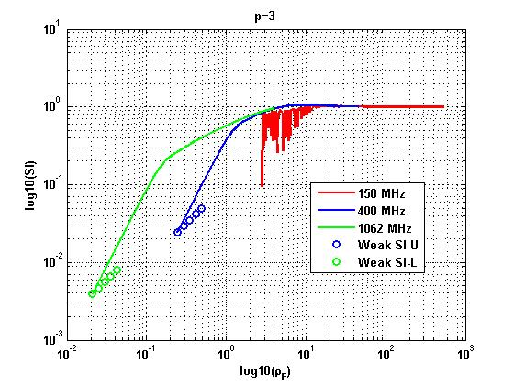
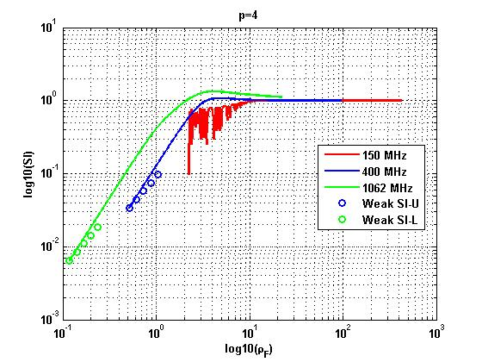
Canonical Example
Phase Screen

Slide 19
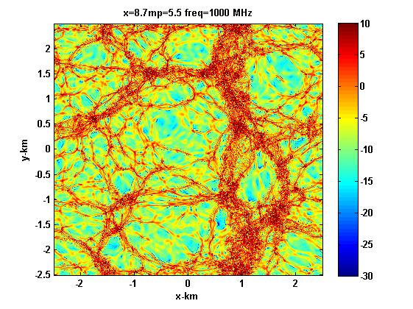
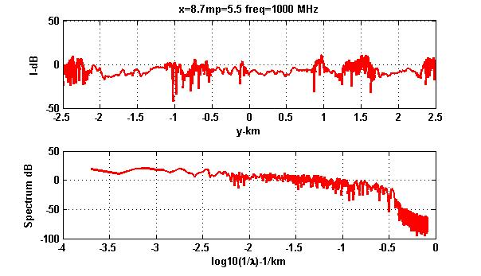
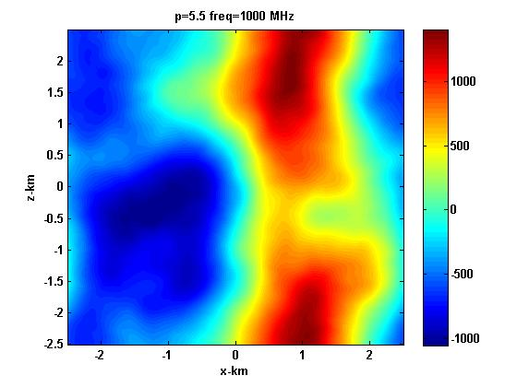
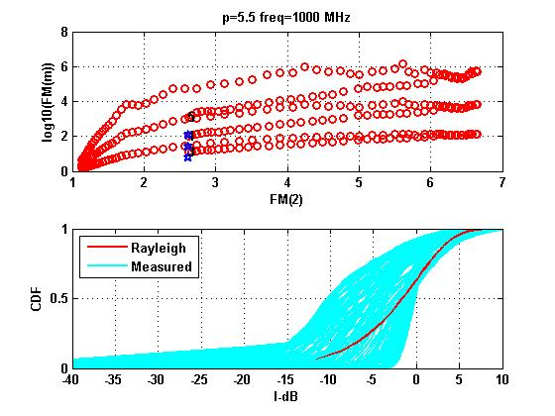
Extreme Scintillation
Phase Screen

Slide 20
Looking Ahead
GPS Beacons together satellite and ground-based diagnostics have revolutionized the study of the near-earth environment
Path-integrated phase interpreted as TEC is a primary input
Sophisticated analysis procedures are seamlessly integrating physics-based models and very large data bases with improving resolution
Propagation analysis should be brought into the same framework
This will require a rethinking of structure formation and the development of new structure models to accommodate the inhomogeneous anisotropic structure that causes scintillation and ultimately limits the performance and utility of GPS
The last paper of the session will discuss iterative parameter estimation as a tool for exploiting strong scatter at L-band
Phase Screen

Slide 21
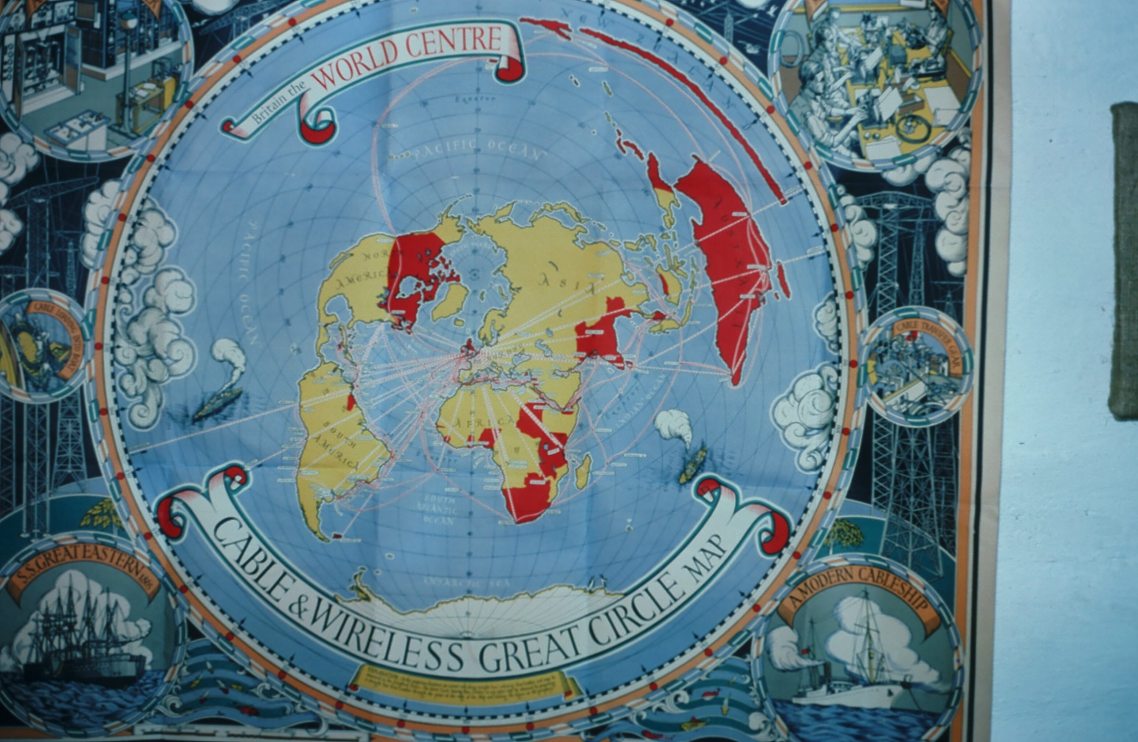
Thank You

Slide 22
LINKS
Phase Screen

Slide 23
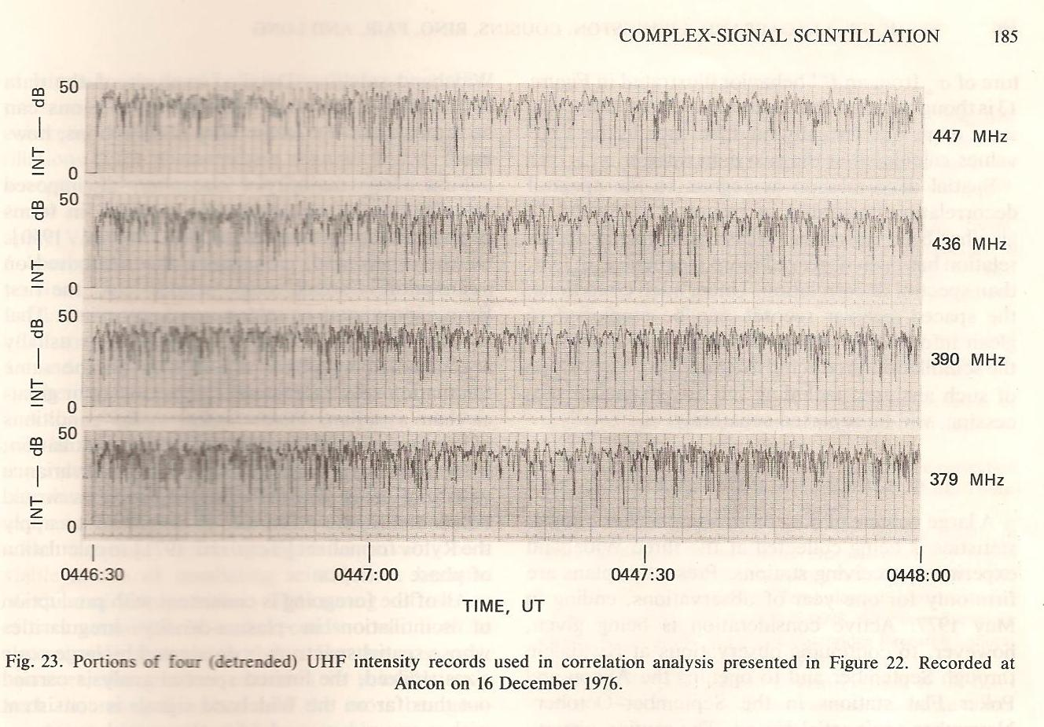

Slide 24
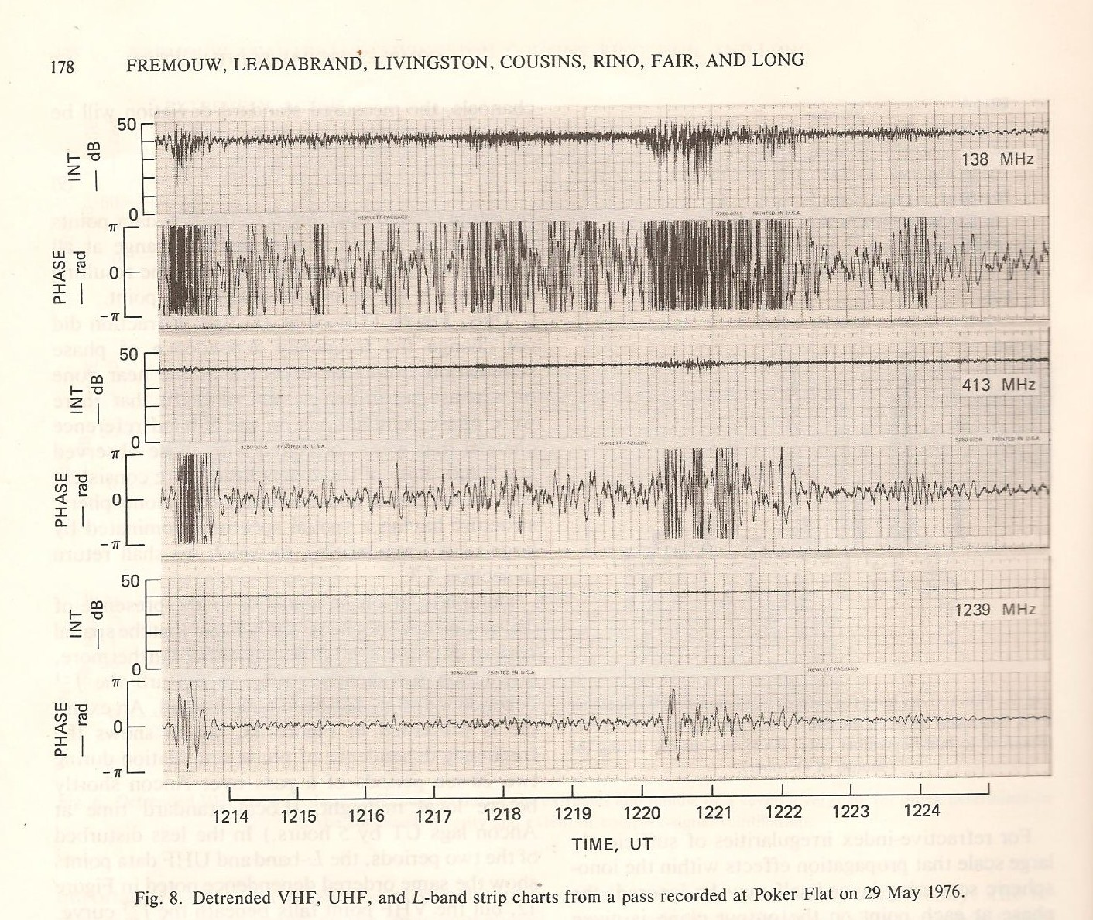

Slide 25
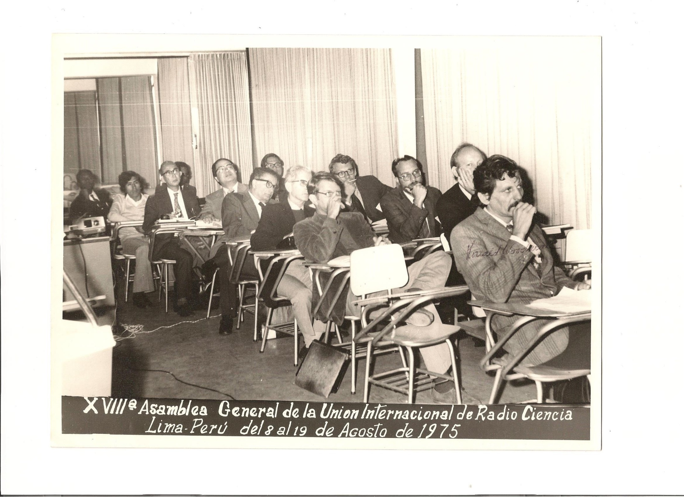
Yeh
Liu

Slide 26
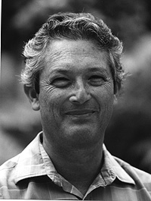
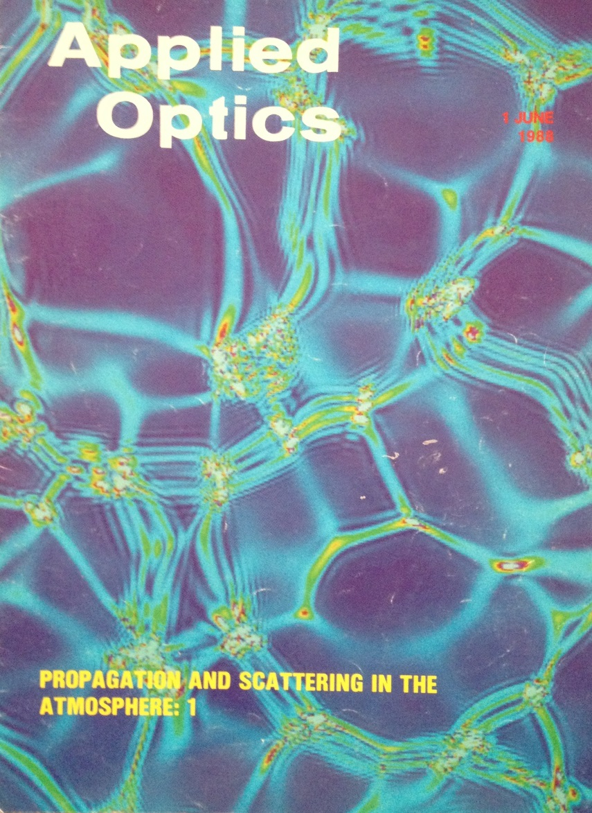

Slide 28
