Slide 1
A Century of Remote IONOSPHERIC “RADIO” Diagnostics
by
Charles Rino
Boston College, Institute for Scientific Research
2022 Beacon Satellite Symposium
1-5 July 2013
Boston College

Slide 2
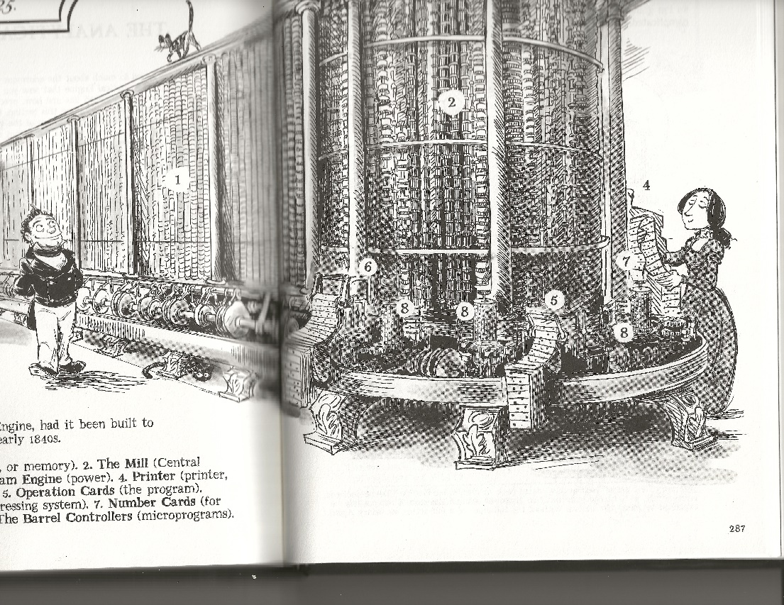
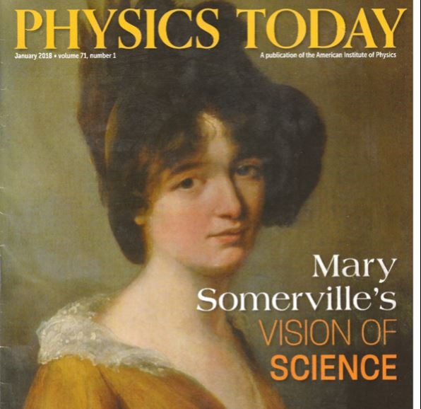
A computer program written 30 years before Maxwell’s equations
Ada Lovelace, daughter of Lord Byron and his “Princess of Parallelograms,” visited Charles Babbage in 1833.
Ada’s mother was a mathematician who studied under Mary Sommerville
In 1843 after studying Babbage’s Analytic engine design with help from Sommerville, Ada wrote some code for the analytic engine, which is now recognized as the first comper program.
The analytic engine was never built. A century went by before Ada’s program, could be executed as she wrote it.
Ada offered to help Michael Faraday with his studies of electricity.
1780-1872
An artist’s rendition of Babbage’s analytic engine from “The Thrilling Adventures of Lovelace and Babbage,” by Sydney Padua
https://writings.stephenwolfram.com/2015/12/untangling-the-tale-of-ada-lovelace/
Notes:
Thirty years before the Birth of Radio Science Ada Lovelace, the daughter of the poet Lord Byron and a mathematician whom Byron in his kinder moments referred to as his “Princess of parallelograms.”

Slide 3
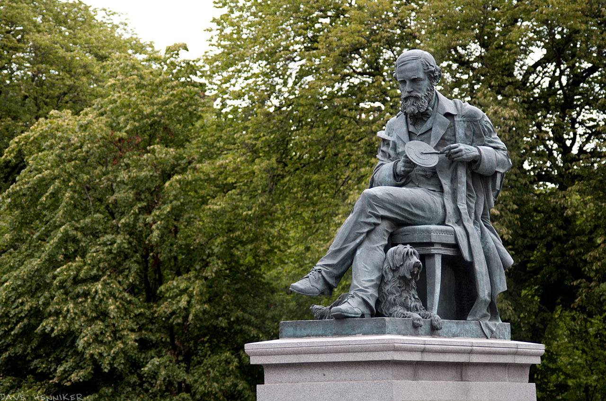
The Birth of Radio Science
James Clerk Maxwell
1831-1879
Publication of Maxwell’s seminal paper in 1865
Followed by experiments conducted by Heinrich Hertz from 1886 to 1889 demonstrating the existence of electromagnetic waves predicted by Maxwell’s equations.
Notes:
We can identify the birth of radio science with the publication of Maxwell’s seminal paper “A Dynamical Theory of the Electromagnetic Field” in 1865.
Chao-han Liu Retirement
Retired from Vista research

Slide 4
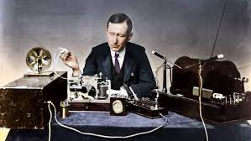
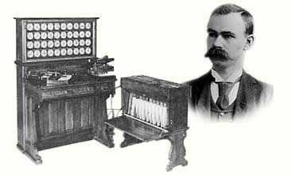
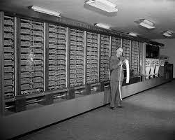
Wireless telegraphy
Relay computation
Starting in 1890 Guglielmo Marconi developed and improved wireless telegraphy, culminating in his 1902 demonstration of transatlantic wireless communication.
He founded a company and shared a Nobel prize
Herman’s company became IBM, which used his switching concept to build computers with thousands of relays referred to as mechanical monsters
MARK IV
At about the same time, Herman Hollerith patented a tabulator with punched-card input and relay switching operatons
Howard Aiken
Notes:
The first machines that could be used to perform prescribed sequences of basic mathematical operations used relay switching logic.
Howard Aiken was inspired by Babbage’s design of his analytic engine.

Slide 5
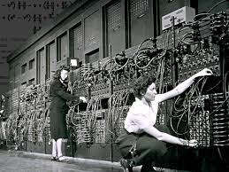
World Wars
Radar
Remote sensing
Radio Communication and Surveillance
Information Theory, Cybernetics
Rocketry
Beacon satellites and space exploration
Nuclear Weapons
Existential threat that profoundly influenced the pace of technology development
Norber Wiener (Cybernetics)
Vannevar Bush (“As We May Think”)
Clude Shannon (Digital Logic, Information Theory)
John Von Neuman (Game theory)
Alan Turing (Artificial Intelligence)
ENIAC
John Von Neuman wrote a report outlining the design of a modern general purpose electronic computer.
The first vacuum tube computer weighed 30 tons and had 18,000 vacuum tubes!
The machine was configured for each computation by a group of young women called the “Mathematical Rosies.”
“ENIAC: The Triumphs and Tragedies of the World's First Computer” by Scott McCartney
“The Dream Machine: J.C.R. Licklider and the Revolution That Made Computing Personal” by M. Michael Waldrop

Slide 6
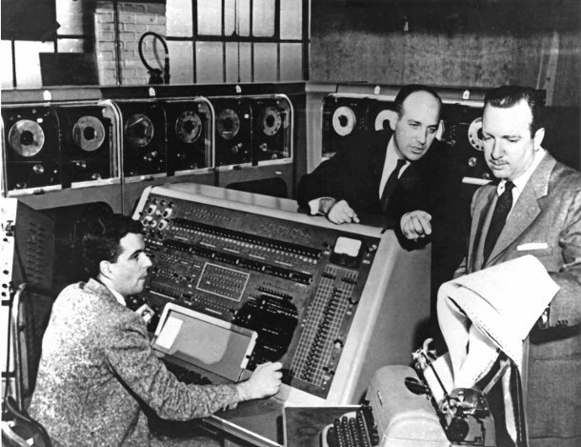
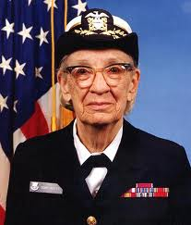
Before Sputnik
In 1950 J. Presper Ekert and John Machley, the designers of ENIAC, started a company, which ultimately developed UNIVAC, a commercial general-purpose electronic computer.
The picture shows a John Machley on TV explaining to Walter Cronkite how the computer correctly predicted Eisenhower as the winner of the 1952 election.
Grace Hopper started her career as a professor of mathematics. After Pearl Harbor she decided to serve her country by joining the military.
She became a Navy Lieutenant and achieved an Admiral rank created for her. Under Cmdr. Howard Aiken she worked on the Mark IV.
As an employee of Machly Computers she wrote the first compiler
Grace’s compiler could have executed the first computer code written by Ada Loveace a century earlier for Babbage’s analytic engine.
UNIVAC
“Grace Hopper and the Invention of the Information Age,” by Kurt W. W. Beyer

Slide 7
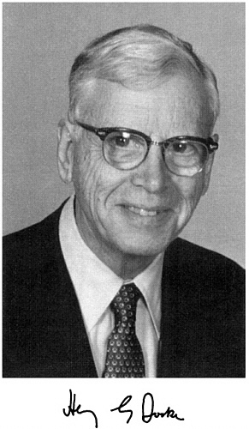
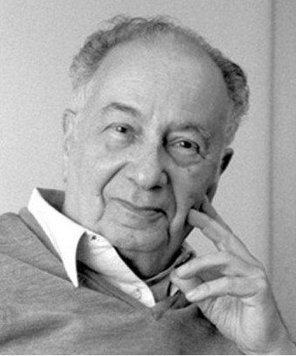
Radio Science ⬄ Radio Astronomy
Henry Booker
1910-1988
Jules Aarons
1921-2008
The prewar to post war-history of radio science before Sputnik is beautifully summarized in Bill Gordons obituary of his dear friend Henry Booker
https://nap.nationalacademies.org/catalog/10169/biographical-memoirs-volume-79
Following Karl Jansky’s 1933 announcement of extra-terrestrial radio sources, Radio Astronomy became Radio Science’s greatest achievement. Jules Aarons exploited the scintillation of radio stars to determine the morphology of global ionospheric structure.

Slide 8
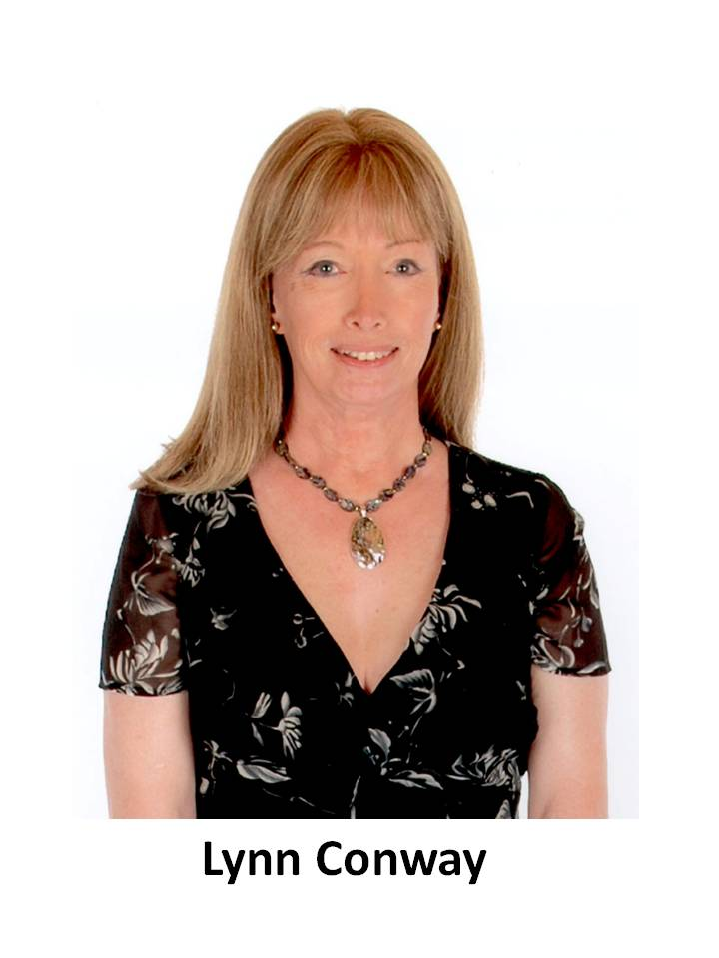
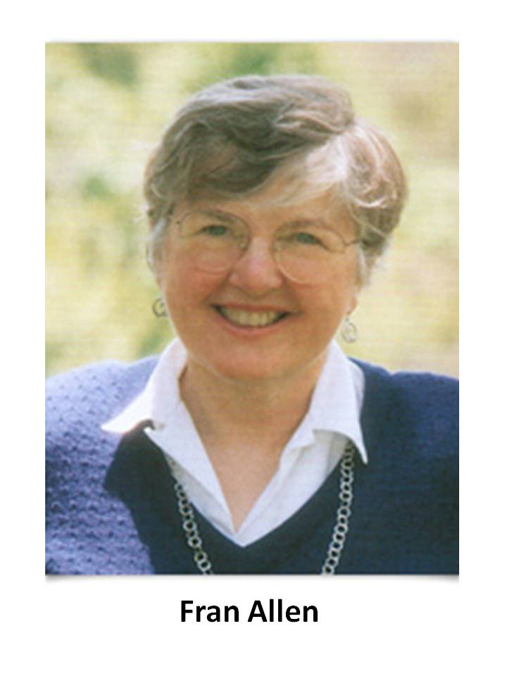
Following Sputnik
The Advanced Research Projects Agency was founded, leading to supercomputers, the internet, and AI
The National Space and Aeronautics Association was founded
Satellite Navigation, ultimately leading to GPS & GNSS
An “avalanche” of support for university, and private basic research
Transistors, Integrated circuits, and the internet followed
Two IBM Women
Francis Allen joined IBM in 1957 to help pay off her education debt. First woman to be elected as IBM fellow and win the Turing award.
Optimizing compilers for super cumputers & PTRAN.
Lynn Conway, a gifted mathematician, also working on super computers was fired by IBM when she transgendered. At Xerox Park and DARPA she went on to codevelop the Symbolic Language for VLSI design.
Notes:
The IBM Stretch was one of the first supercomputers and was the fastest computer in the world for several years. Designed in the 1950s, it included many advanced techniques that influenced many supercomputers that followed. This included innovations like preprocessing the instruction stream to handle branches as early as possible and out-of-order execution. Key to getting the desired performance from the Stretch was the design of the compiler. This was largely the responsibility of a woman named Frances Allen.
Fran didn’t intend to work with computers. She studied math and taught high school math until she completed her master’s degree in Math at University of Michigan in 1957. She joined IBM to pay off college debt. Her first job was to teach FORTRAN to other researchers. She learned it by reading the compiler code. She was hooked. Since the early 1960s she has worked in compiler optimization.

Slide 9
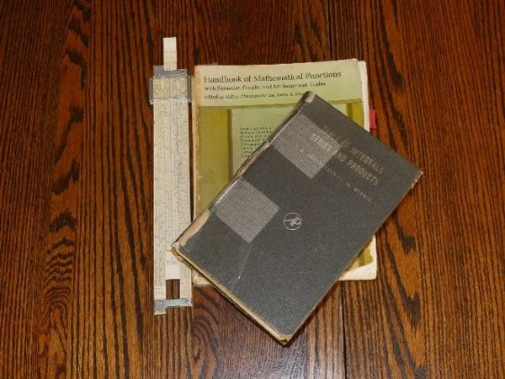
Radio Science Toolbox Evolution
1968 -1972
1972 HP 35 calculator displace slide rule
Gradshteyn
Ryzhik
Mainframes
FORTRAN 1957
Phase Screen

Slide 10
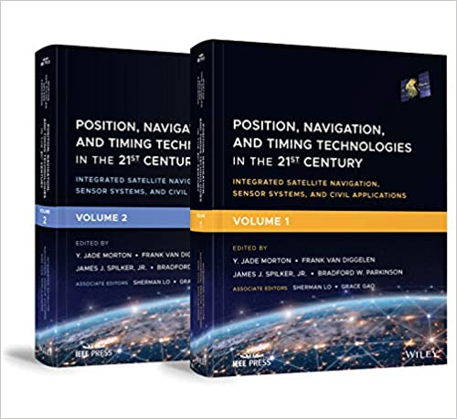
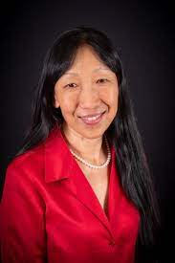
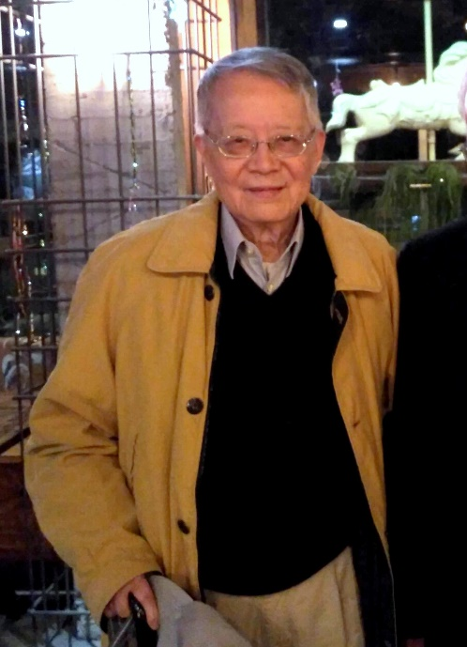
Beacon Satellite Symposium
In Name Only
The Future of Radio Science
GPS/GNSS & COSMIC
Phase Screen
Jade Morton
Chao-han Lu

Slide 11
End Note
Field Intensity
Refractive Index
Phase Screen
Direction Tangent
The blue curves in the right figure are from a multiple-phase-screen calculation of the field in the Chapman layer environment
The MPS-ray trace disparity is a fundamental limitation of the method
See Charlie Carrano’s talk.
The white trace in the left figure shows the ray path of a 10 MHz signal launched into a Chapman layer above a spherical earth
Effectively, a model calculation of Marconi’s experiment at a higher frequency

Slide 12
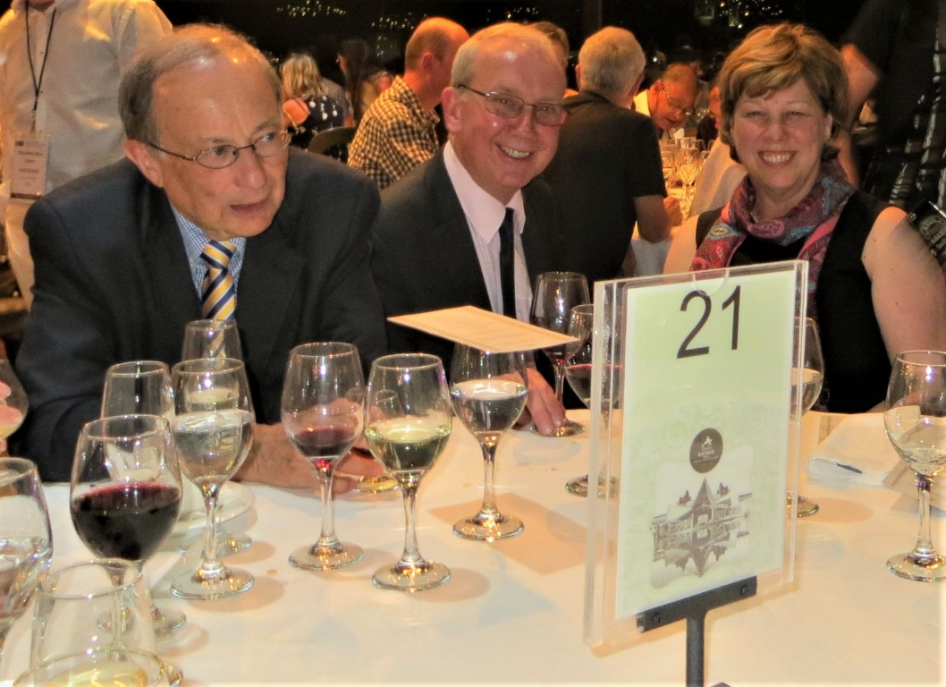
Dedicated to Patricia Doherty
Phase Screen
Pat thank you for being my angel

