Slide 1

Extreme Scintillation Observed During the May 24 Geomagnetic Storm
by
Charles Rino, Luca Spogli, Charles Carrano, Theadore Beach, and Dmytro Vasylyev, Keith Groves
November 11, 2025

Slide 2


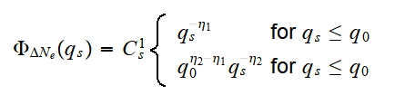

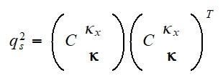
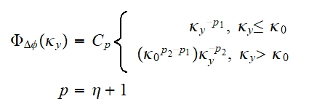
Background
Scintillation is caused by propagation through stochastic electron density structure spanning scales from tens of kilometers to hundreds of meters
Electron density enters scintillation theory formally via frequency-dependent path integrals with phase units
4-parameter SDF model
Path Integration Diagnostics
Observable
1D Projection
<= z invariant
3D
1D
2
4
1
3
Structure characterization <=
A coordinate system reference
4 structure parameters

Slide 3
Background
A rigorous theory of scintillation connects observable complex field moments via first-order differential equations to combinations of structure functions, which are formally variances of path-integrated phase differences
Because of the computational demands of integrating the complex field moment equations diagnostic measurements rely on either weak-scintillation theory or multiple-phase-screen (MPS) simulations
The common challenge is to accommodate or mitigate diffraction effects that distort the path-integral structure relation

Slide 4

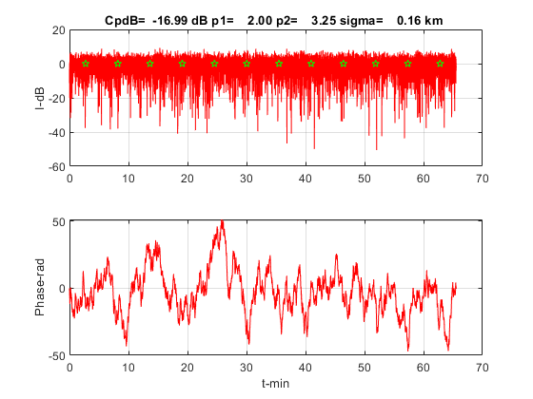
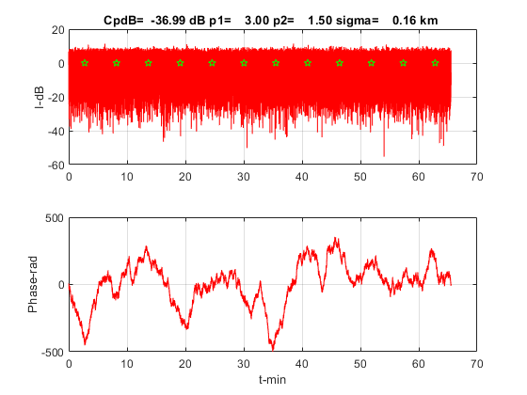
Extreme L-Band Scintillation
Simulation
MPS
FREE SPACE
EPB
PPB

Slide 5
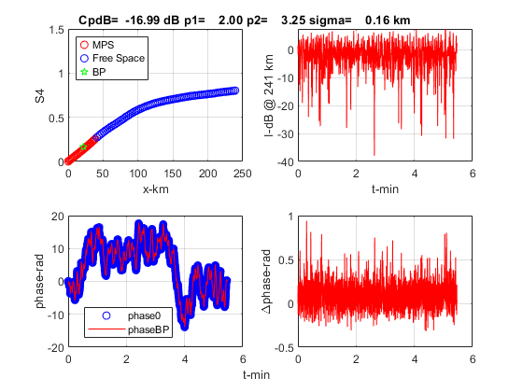
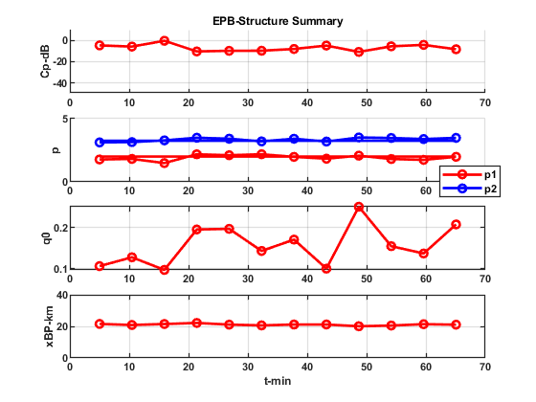
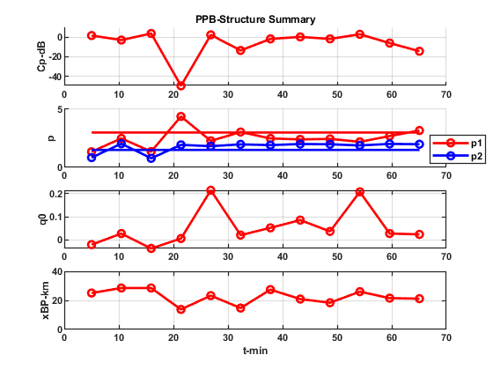
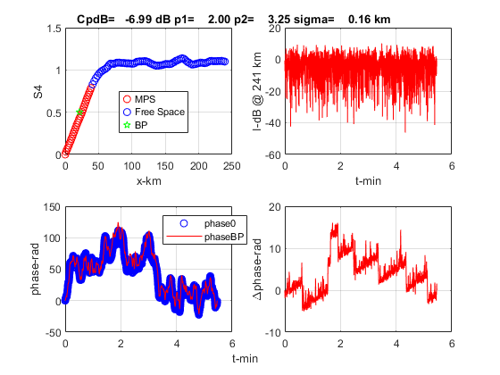
Back Propagation

Slide 6
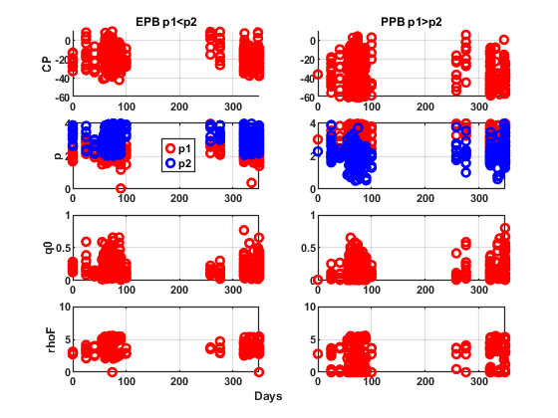

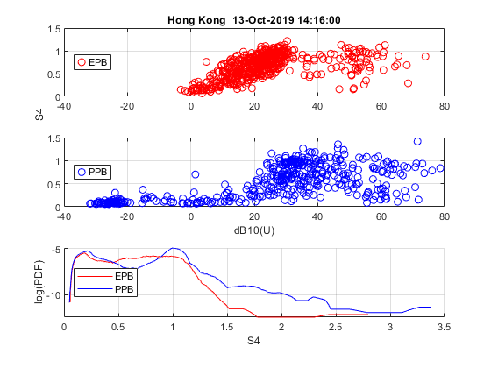
Hong Kong
BP-IPE Structure Parameters
Theory => universal strength parameter
should order scintillation intensity
“Significant” Scintillation Events
October 2013 to July 2015
1044 5-min Segments
504 EPB 540 PPB
61 ~ 1-hr+ Passes
25 EPB >60%
20 PPB >60%

Slide 7
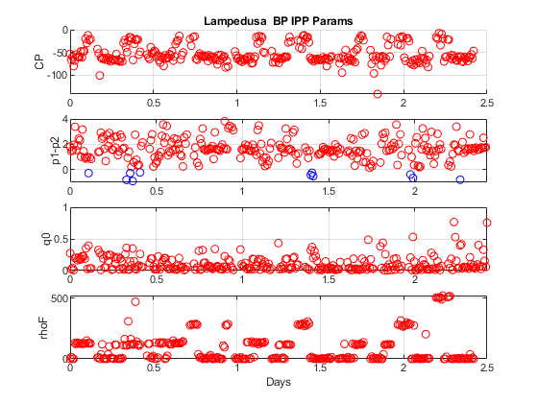
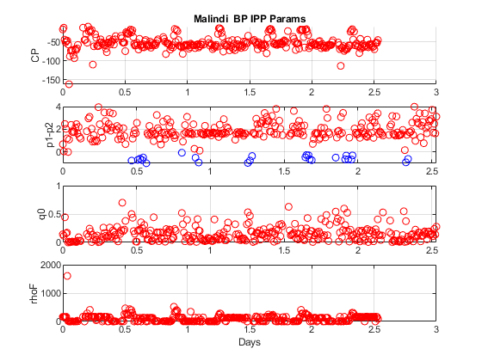
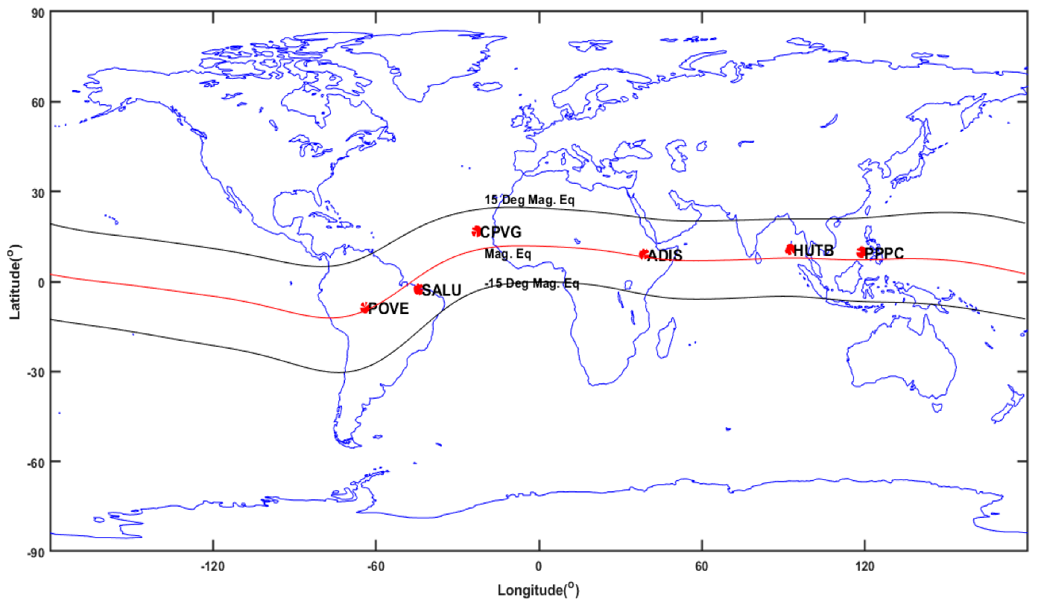
Milandi-Lampedusa
BP-IPE Structure Parameters
10 May 2024
Gannon Storm
18 March 2019
Remarkably similar structure patterns from southward (Lampedusa) and northward looking (Malandi) stations
Complete dominance of PPB structure

Slide 8
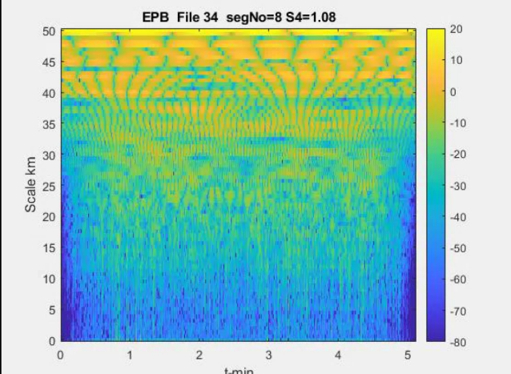
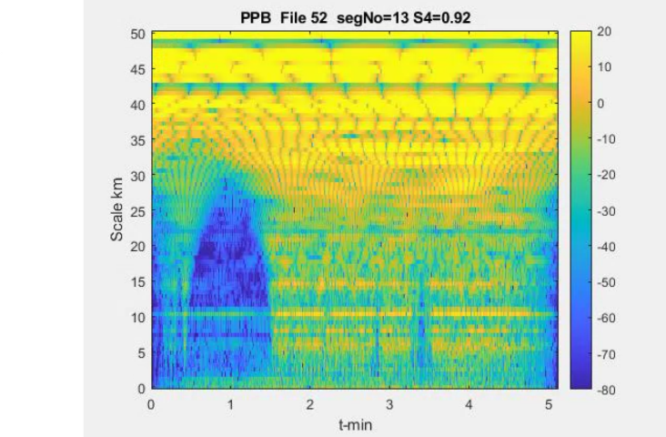
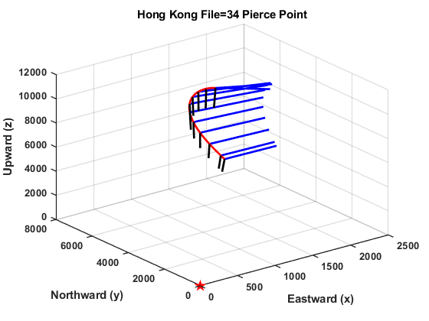
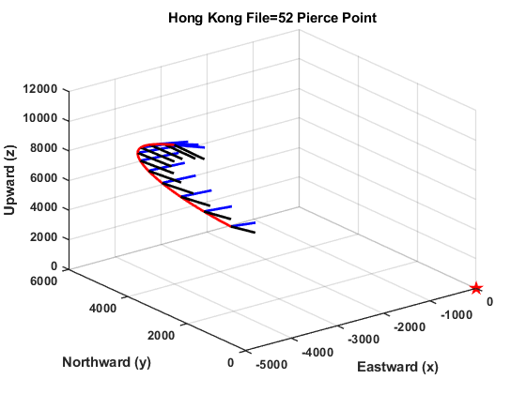
Iterative Filter
EPB PPB Comparison
Segment phase extracted from complex field after back propagation
dB intensity of segment FIF with mode # reported as estimated dominant FFT scale
Segment penetration point trajectory with black ray pointing to station and blue ray pointing along magnetic field
Oblique
Cross Field

Slide 9
Summary & Conclusions
We demonstrated using MPS that applying IPE to the signal phase after back propagation identified two equatorial scintillation structures:
Equatorial Plasma Bubbles (EPB) <= p1<p2
Prominent Plasma Bubbles (PPB) <= p1>p2
From a one-year equatorial campaign sampling strong scintillation at Hong Kong EPB and PPB structures were found in nearly equal numbers
Individual passes tended to favor a single structure category
Extreme scintillation with S4>=1 was observed for both EPB and PPB structures
More recent data from stations observing into the equatorial region from the north (Gannon Storm) and from the south had predominantly PPB structure signatures
We suspect that passes with more nearly cross-field trajectories are associated with EPB structures and oblique but not necessarily meridional passes favor PPB structure

Slide 10
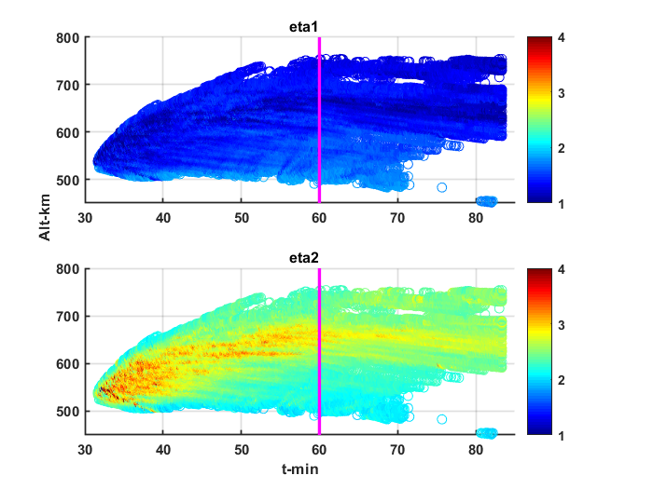
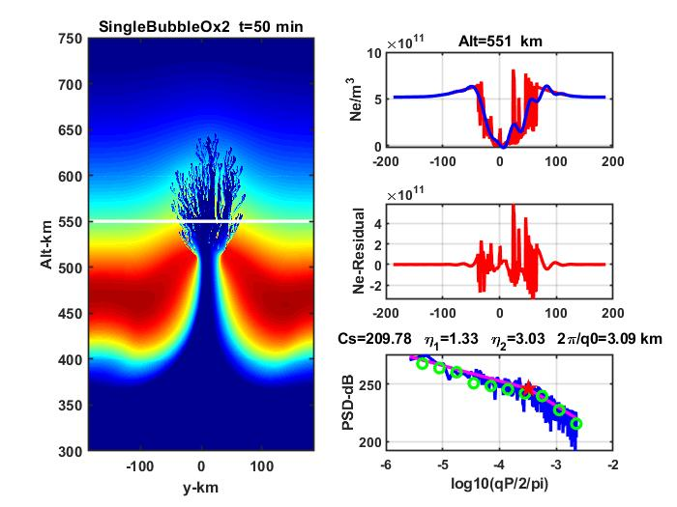
EPB SDF Analysis Summary
IPE
Analysis

