Slide 1

Equatorial Ionosphere Structure Variation Induced by Magnetic Field Curvature
by
Charles Rino, Charles Carrano, Tatsuhiro Yokoyama, Dmytro Vasylyev, Luca Spogli, and Yu Morton
Ionospheric Effects Symposium
May 19-21, 2026
Alexandria, Virginia

Slide 2

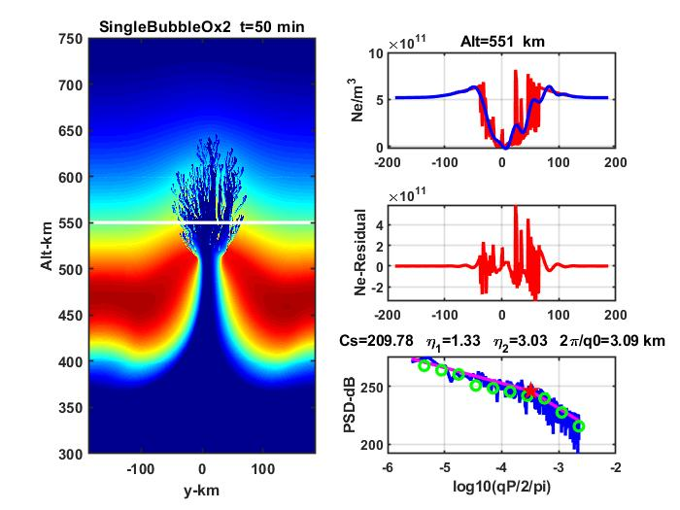

Background
There is considerable support for using a two-component inverse-power-law spectral density function to characterize ionospheric structure associated with developed equatorial plasma bubbles (EPBs).
Additionally, high-resolution physics-based simulations have revealed a definitive characterization summarized below:
From phase scintillation diagnostics spectral indices with p1<p2 were expected. However, analyses of equatorial GNSS data revealed a preponderance of structure with p2>p1 implying enhanced large-scale structure not readily associated with EPBs.

Slide 3
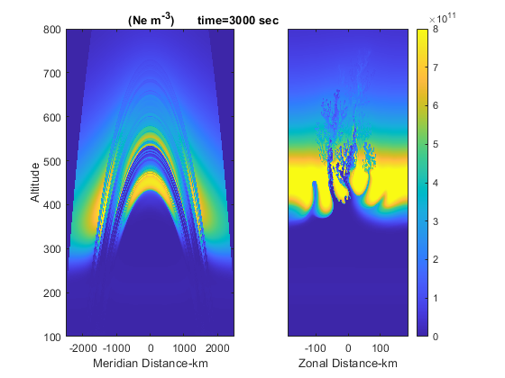
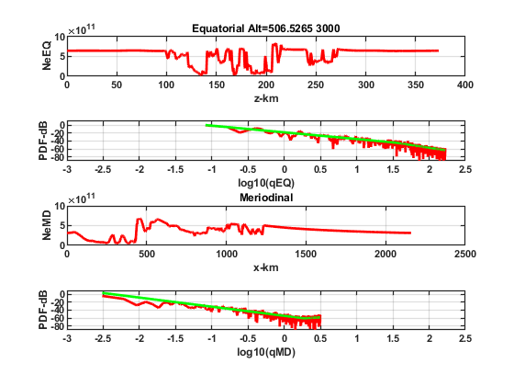
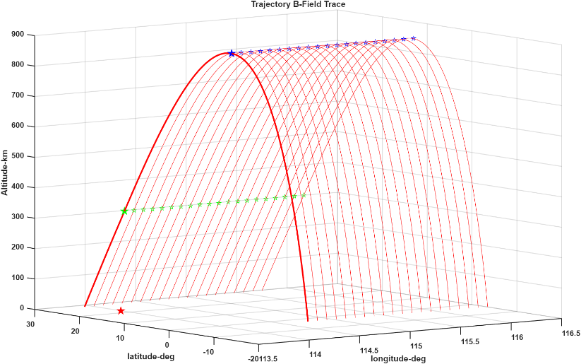
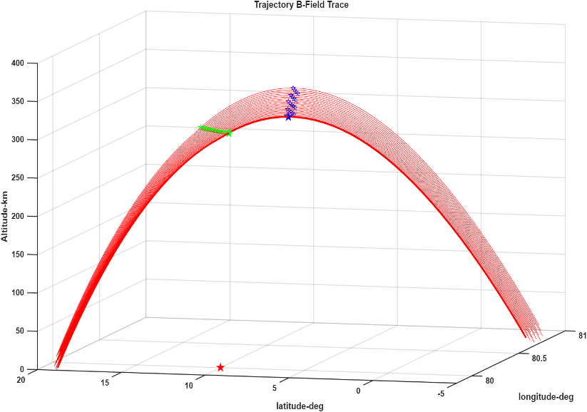
Structure Variation
Induced by B-Field Convergence
Favorable
Geometry
Cross field
Unfavorable
Geometry
Field parallel component

Slide 4
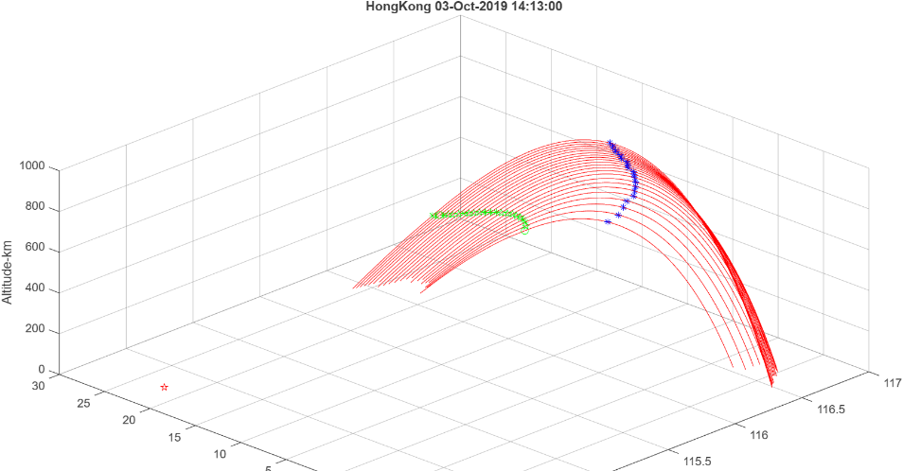
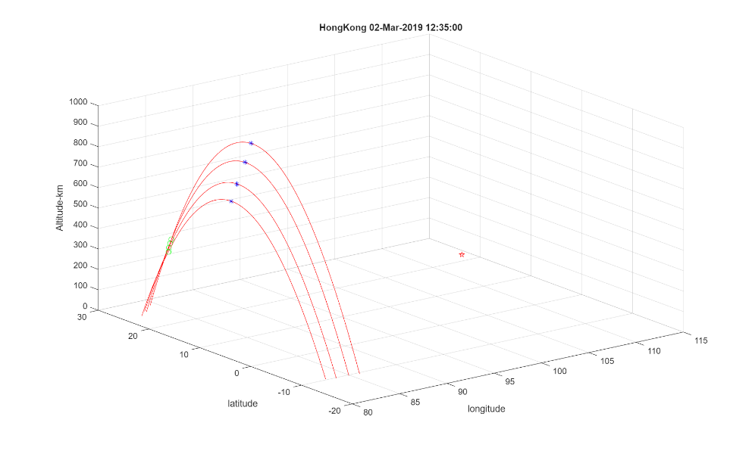
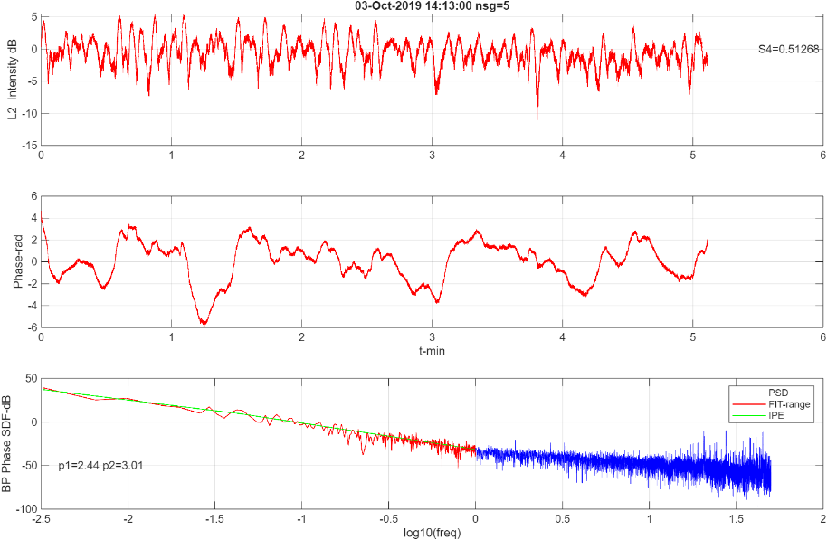
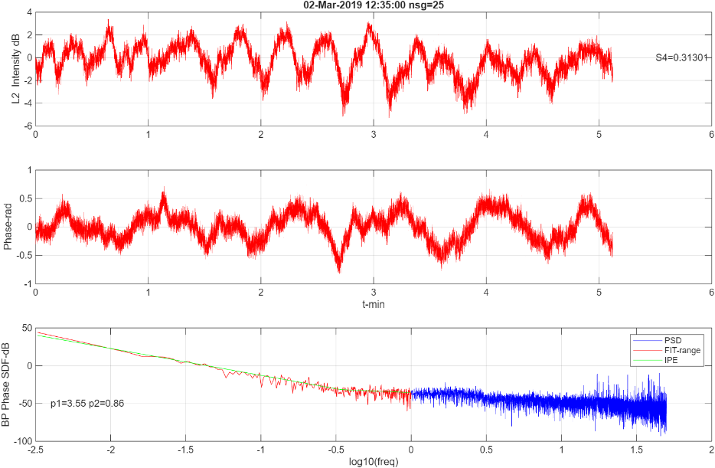
Hong Kong Examples
Favorable
Geometry
Unfavorable
Geometry

Slide 5
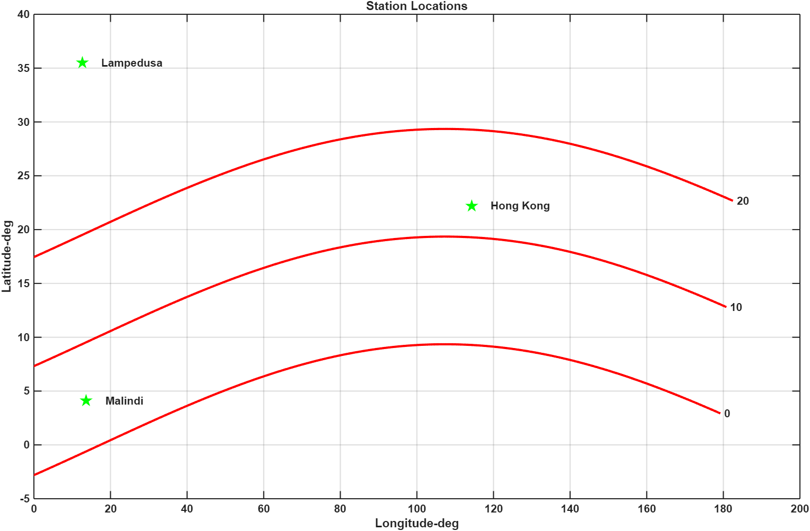
BP IPE Segment Structure Summary
Segment Structure Summary
Hong Kong 1159 segs
EPB PPB P12
BP_OK=722 85 314 323
EX_OK=193 32 88 73
Lampedusa 586 segs
EPB PPB P12
BP_OK= 321 7 144 170
EX_OK= 11 0 4 7
Malindi 646 segs
EPB PPB P12
BP_OK= 377 9 228 140
EX_OK= 377 9 228 140
Fewer than 10% of the segments had verified EPB structure
A small number of PPB passes were attributed to unfavorable geometries
90% of the PPB passes could not be associated with EPB structure
Extreme scintillation structure diagnostics https://doi.org/10.1016/j.jastp.2026.106805

Slide 6
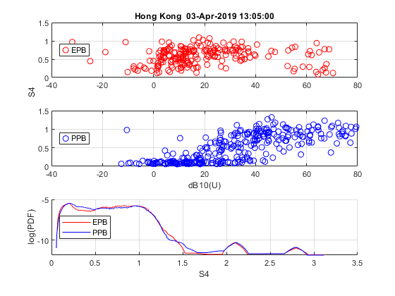
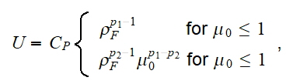
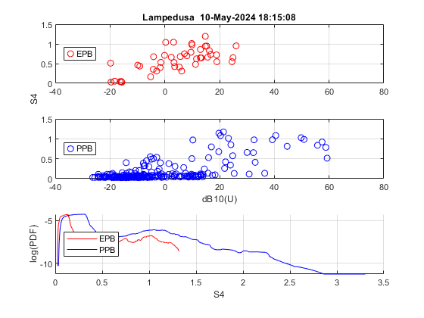
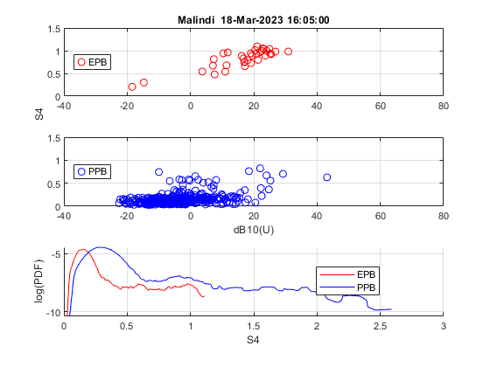
EPB PPB Comparison
PPB structure => 20 dB U shift
associated mainly with large p1

Slide 7
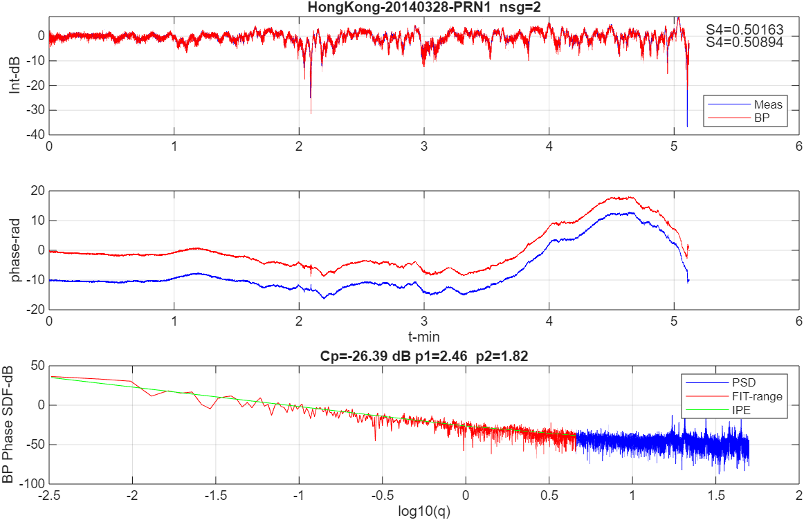
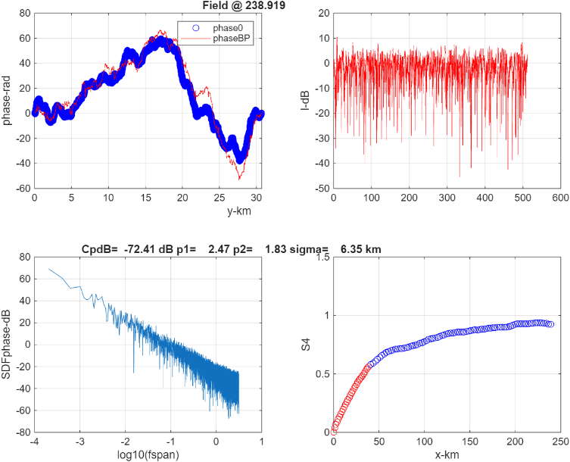
PPB Structure
BP IPE
MPS
MPS simulations using PPB parameters
generate statistically equivalent realizations

Slide 8
Summary and Conclusions
The characteristic two-component EPB structure was found in low latitude GNSS data only in a small number of segments with favorable field connections from penetration points to the geomagnetic equatorial plane (e. g. Slide 4 left frame).
Convergent field geometry accounted for p1>p2 in only a small number of segments.
More than 90% of the moderate to strongly scintillating segments were associated with enhanced large-scale structure (e. g. Slide 5).
The association large-scale variations are readily identified in the BP phase.
The large-scale variations are suggestive of traveling ionospheric disturbances.
Additional diagnostic analyses of large-scale structure are being pursued to determine the source of the PPB structure.

Slide 9
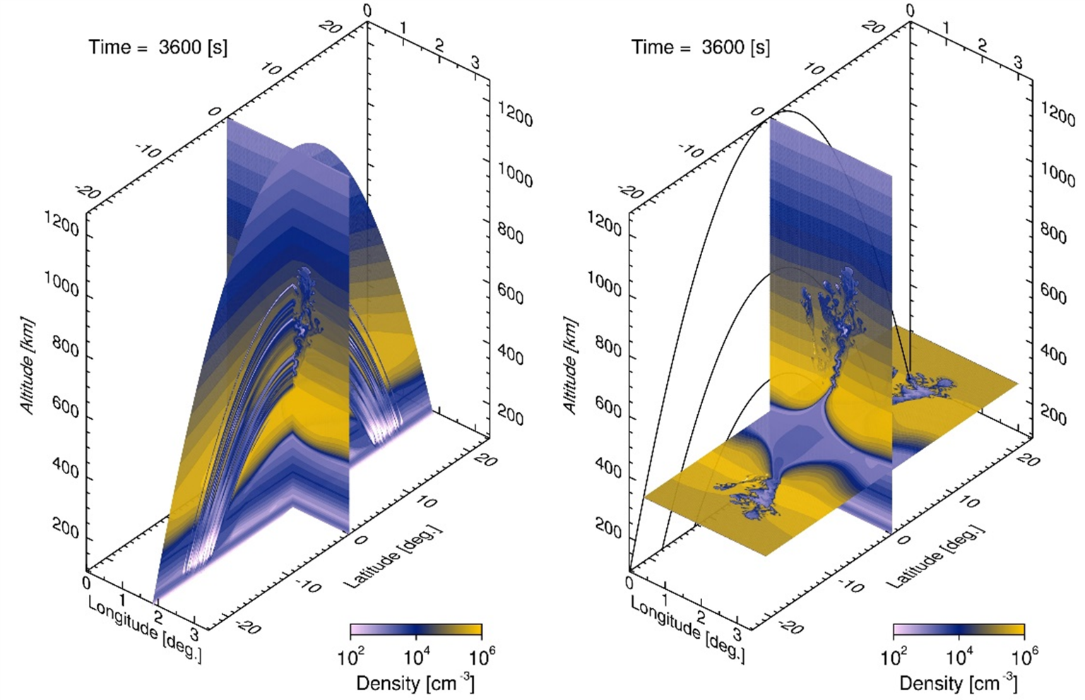
Backup
Meridian-plane sampling captures large-scale structure
Cross-field sampling resolves the defining 2D EPB structure

Slide 10
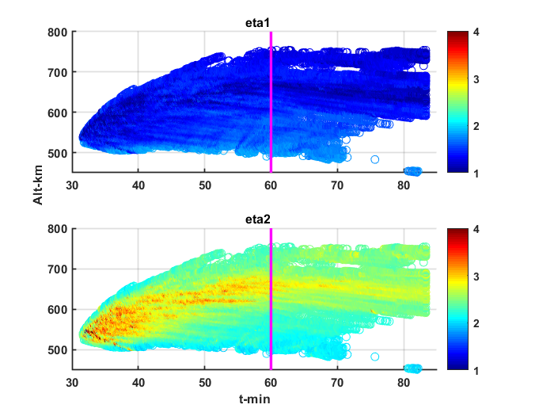
Backup
EPB Structure Evolution

